Slide 1

Data structures
Ankitha C
Arpitha K V
Bavitra S
Rithika D Prakash
Ruchika Jain
Subhashree M

Slide 2
BY DEFINITION
CONCEPT OF DATA STRUCTURES
A data structure is a data organization, management, and storage format that enables efficient access and modification. More precisely, a data structure is a collection of data values, the relationships among them, and the functions or operations that can be applied to the data.
DATA
FETCH
PROCESS
STORE

Slide 3
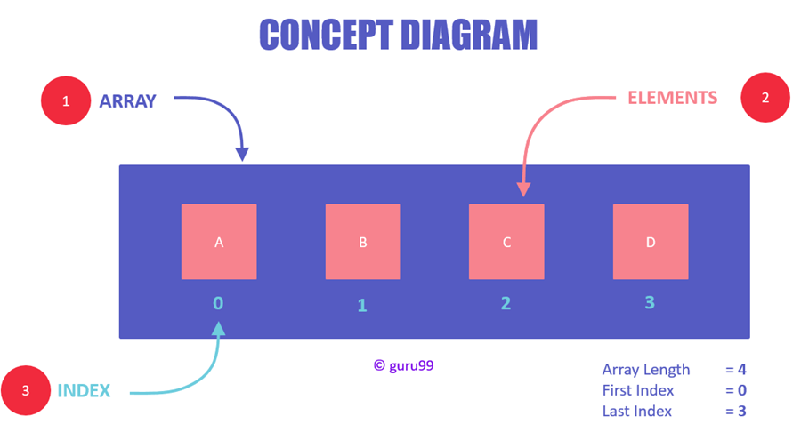
ARRAYS
An array data structure, or simply an array, is a data structure consisting of a collection of elements, each identified by at least one array index or key.
There are two types :Single dimensional and multidimensional

Slide 4
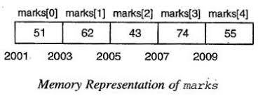
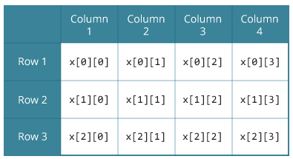
APPLICATIONS OF ARRAYS :
POST OFFICE BOXES
BOOK PAGES

Slide 5
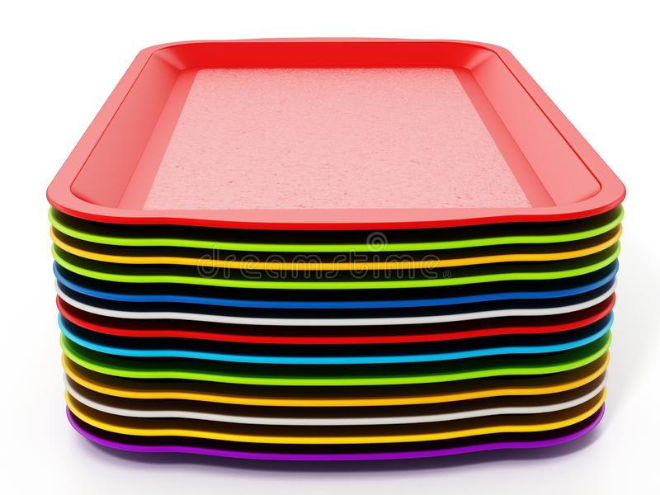
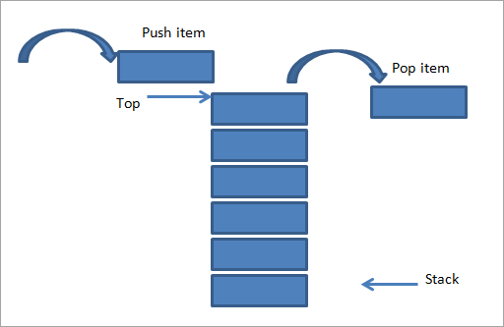
STACKS
Stack is an ordered list of similar data type.
Stack is a data structure that follows the principle of LIFO(Last In First Out) or FILO(First In Last Out).
A real-world example would be a stack of trays.

Slide 6
OPERATIONS OF STACK
●push: Adds an item to the stack.
●pop: Removes an item from the stack.
●top: Returns the top element of the stack.
●isEmpty: Returns the status of the stack.
APPLICATIONS OF STACK
●Balancing of symbols
●Redo and undo features in editors and photoshops
●Forward and backward feature in web browsers

Slide 7
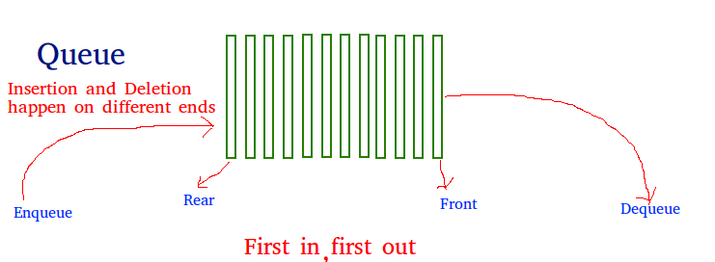

QUEUE
A Queue is a linear structure which follows a particular order in which the operations are performed.
It follows FIFO unlike stacks.
A real world example of queue can be a single lane one way road, where the vehicle enters first, exits first.

Slide 8
OPERATION ON QUEUES:
Enqueue: Adds an item to the queue. If the queue is full, then it is said to be an Overflow condition.
Dequeue: Removes an item from the queue. The items are popped in the same order in which they are pushed. If the queue is empty, then it is said to be an Underflow condition.
Front: Get the front item from queue.
Rear: Get the last item from queue.
peek() − Gets the element at the front of the queue without removing it.
isfull() − Checks if the queue is full.
isempty() − Checks if the queue is empty.
APPLICATION:
Used in breadth first search algorithm and other graphs algorithm.
Schedulers in Operating Systems.
In routers, to smoothen out bursts.

Slide 9
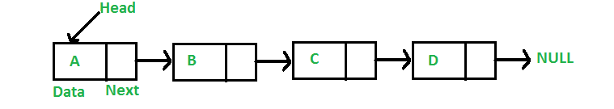
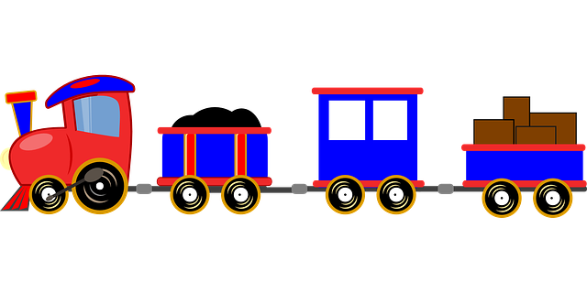
LINKED LIST
A linked list is a linear data structure, in which the elements are not stored at contiguous memory locations.
The elements in a linked list are linked using pointers as shown in the below image:
In simple words, a linked list consists of nodes
where each node contains a data field and a reference(link) to the next node in the list.
A simple real life example is a Train, here each coach is connected to its previous and next coach (Except first and last).
In terms of programming consider coach body as node value and connectors as links to previous and next nodes.

Slide 10
Dynamic Data Structure
No need to give initial size of linked list.
Insertion and Deletion
No shift of elements after insertion or deletion of an element is needed. In linked list we just have to update the address present in next pointer of a node.
No Memory Wastage
As size of linked list can increase or decrease at run time so there is no memory wastage
Memory Usage
More memory is required to store elements in linked list as compared to array.
Traversal
Elements or nodes traversal is difficult in linked list. We can not randomly access any element as we do in array by index.

Slide 11
APPLICATION OF LINKED LIST
Previous and next page in web browser : Consider the history section of web browsers, where it creates a linked list of web-pages visited, so that when you check history (traversal of a list) or press back button, the previous node's data is fetched.
File System Handling: For example the file allocation table contains a sequential list of locations where the files is split up and stored on a disk.
Remember that overtime it is hard for an OS to find disk space to cover the entire file so it usually splits these up into chunks across the physical hard drive and stores a sequential list of links together as a linked list.

Slide 12
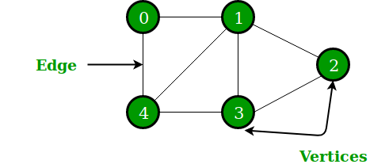
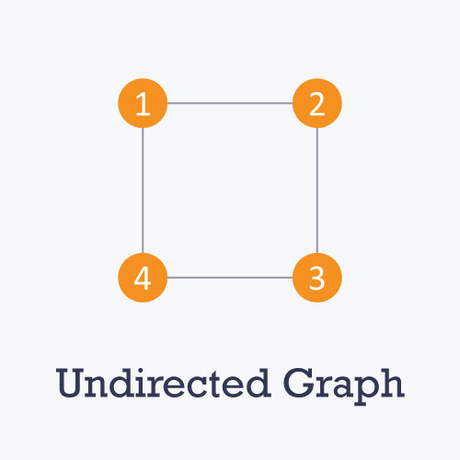
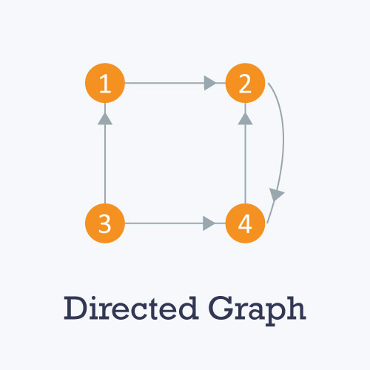
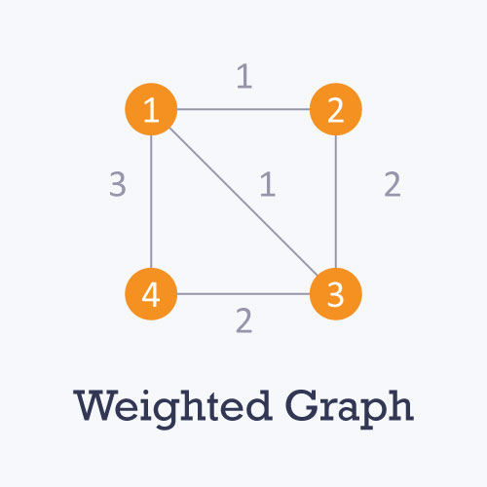
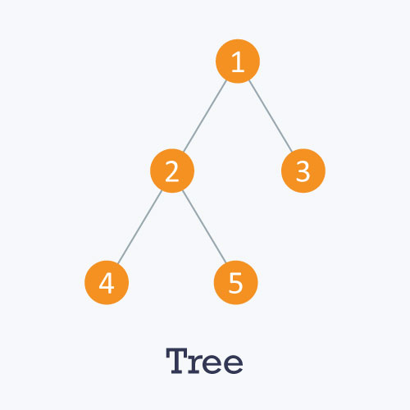
Data structure-Graph
A Graph is a non-linear data structure consisting of nodes and edges. Formally, a graph G is a pair of sets (V, E), where V is the set of vertices and E is the set of edges connecting the pairs of vertices.
V = {0, 1, 2, 3, 4}
E = {01, 12, 23, 34, 04, 14, 13}
Types of graphs

Slide 13
Graph Representations
Adjacency Matrix
Graph
Adjacency List

Slide 14
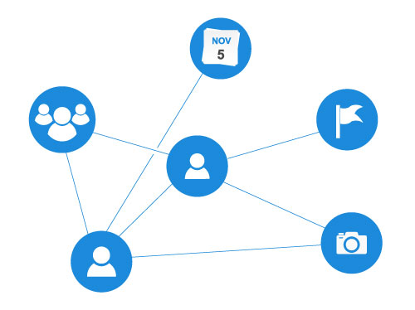
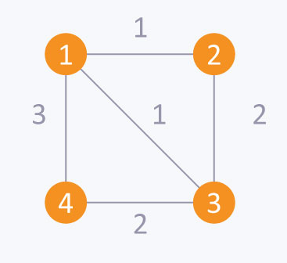
Applications of Graph Data Structure in Real Life
Google maps uses graphs for building transportation systems, where intersection of two(or more) roads are considered to be a vertex and the road connecting two vertices is considered to be an edge.
In Facebook, users are considered to be the vertices and if they are friends then there is an edge running between them.
In World Wide Web, web pages are considered to be the vertices. There is an edge from a page u to other page v if there is a link of page v on page u.
Path optimizations are primarily occupied with finding the best connection that fits some predefined criteria.

Slide 15
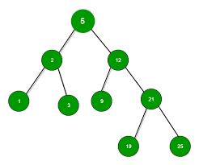
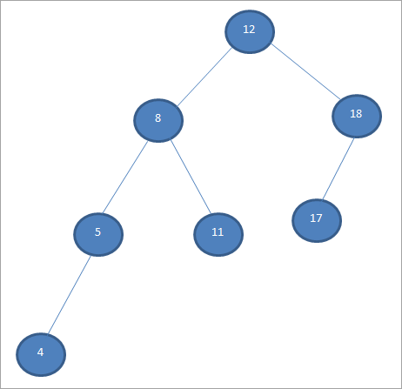
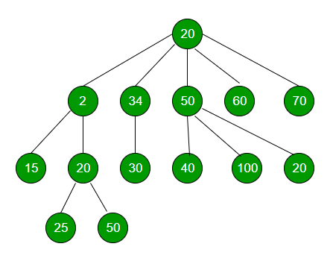
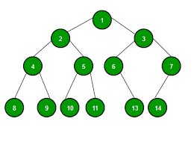
TREE
A tree is a nonlinear hierarchical data structure with a root value and sub trees of children nodes with a parent.
TYPES:
Binary Tree
Binary Search Tree (BST)
AVL Tree (Self Balancing Tree)
N–ary Tree
BINARY TREE
AVL TREE
N-ARY TREE

Slide 16
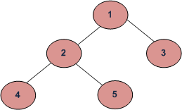
TREE TRAVERSAL
(a) Inorder (Left, Root, Right) : 4 2 5 1 3 (b) Preorder (Root, Left, Right) : 1 2 4 5 3 (c) Postorder (Left, Right, Root) : 4 5 2 3 1
APPLICATIONS
Store hierarchical data, like folder structure, organization structure, HTML data.
BST allows fast search, insert, delete on a sorted data.
Used to implement dictionaries with prefix lookup.
For quick pattern searching in a fixed text.
Spanning Trees and shortest path trees are used in routers and bridges respectively
in computer networks
As a workflow for compositing digital images for visual effects.

Slide 17
THANK YOU

